Slide 1
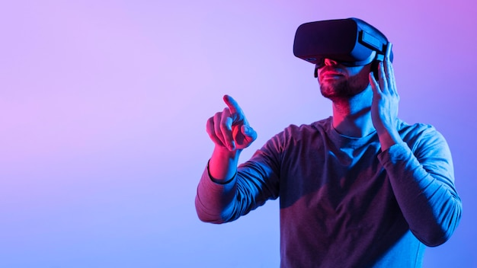
AR and VR in Medical Field

Slide 2
AR:-
Augmented reality is an enhanced, interactive version of a real-world environment that achieve visual elements, sounds, and other sensory
AR users can control their presence in the real world
AR can be accessed with a smartphone
AR enhances both the virtual and real world

Slide 3
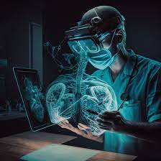
VR:-
Virtual Reality (VR) is a computer-generated environment objects that appear to be real, making the user can feel their surroundings
VR users are controlled by the system
VR requires a headset device
VR only enhances a fictional reality.

Slide 4
Medical Field:-
One of the most useful applications of AR and VR in modern medicine is surgery
Reasons:-
provides direct visualization of the patient's anatomy in a three-dimensional format.
surgeons can mimic real surgical procedures and anatomy, boosting preparedness and efficiency in the operating room

Slide 5
AR and VR works in Medical Fields:-
1. Training and Education
2. In-hospital and Remote Surgery
3. Mental Health Problems Treatment
4. Advanced Diagnosis

Slide 6
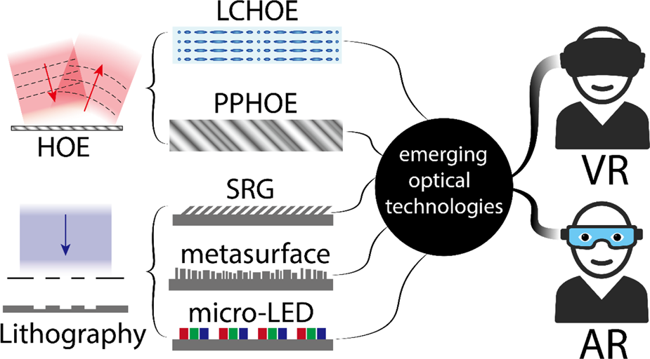

Slide 7
How AR and VR works in medical fields:-
Augmented Reality (AR):-
AR can provide doctors with real-time data and insights during surgeries or medical procedures
For example:-
surgeons can use AR headsets to visualize patient anatomy overlaid with relevant medical information, such as CT scans or X-rays, directly within their field of view.

Slide 8
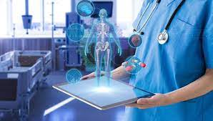
Virtual Reality (VR):-
VR creates computer-generated environments that users can interact with using specialized headsets or devices.
For Example:-
VR environments can distract patients during painful procedures, such as dental procedures, by transporting them to relaxing virtual landscape.

Slide 9
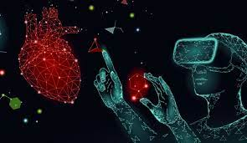
Conclusion:-
AR and VR technologies have the potential Power to enhance medical training Data’s
And provide innovative solutions for diagnosis, treatment in the medical field

